Slide 1
Innovation in Public Service Delivery
Gheorghe Ursoi
Public administration reform expert
Policy Advisor Belgrade 25.05.2023

Slide 2

The fundamentals
Availability of the E governance infrastructure
Modernization of the public services including delivery
Accessibility for the beneficiaries

Slide 3











ELECTRONIC SERVICES INFRASTRUCTURE
SECURITY
AND IDENTITY
DIGITAL
SIGNATURE
CLIENT SUPPORT
ELECTRONIC PAYMENTS
ELECTRONIC SERVICE
ELECTRONIC MESSAGING
DELIVERY
HOSTING
INTEROPERABILITY

Slide 4

Mobile signature provided by main mobile services providers
Electronic signature provided by the Government
Almost ready: MobiSign - offers a secure electronic authentication and signing mechanism, easy to use and absolutely free.
Notes:
The MobiSign mobile e-signature and identity service is an e-identity solution based on mobile applications and its main objective is to provide the tool for authentication and signing of electronic documents, including through information systems integrated with the MSign e-government e-signature service and the government’s authentication and access control service, MPass.

Slide 5
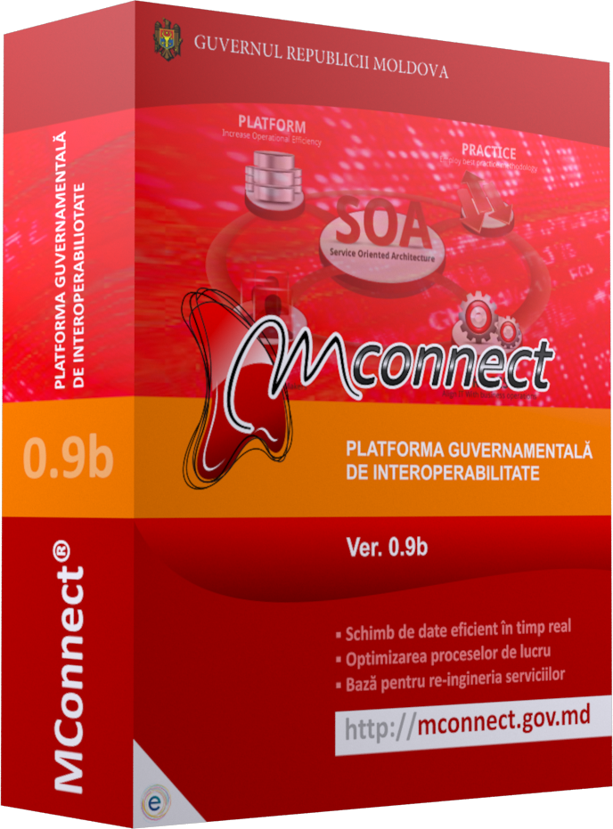
Interoperability Platform
  adapts to existing connectivity capabilities
  ensures IT systems interoperability in the public sector
  facilitates efficient and secure data exchange and reuse by connecting the state-owned information resources and services
  offers a favorable framework for public services optimization through reusing information resources and services;
  ensures a favorable framework for an open government through automatic mechanisms for collection and publishing of open government data.
Notes:
The MConnect interoperability platform is the technological solution developed by the Government of the Republic of Moldova to ensure interoperability and data exchange between information systems. The purpose of the interoperability platform is to facilitate, but also to streamline data exchange and interoperability within the public sector, as well as between the public and private sectors, in order to increase the quality of public services provided, create new electronic public services and ensure information security .

Slide 6
MOVING FROM THIS …
Tax Service
Customs
SOE
Registru
NB of Statistics
Prosecutors
Anticorruption Commission
Social Assurance
Authority
SOE
Cadastre
Medical Assurance
Authority
Min. of
Justice

Slide 7
… TO THIS
Tax
Service
Customs
SOE
Registru
NB of Statistics
Anticorruption Commission
Prosecutors
Social Assurance
Authority
SOE
Cadastre
Medical Assurance
Authority
Min. of Justice

Slide 8
PUBLIC SERVICES MODERNIZATION
RATIONALIZATION
REENGINEERING
DIGITIZATION
DELIVERY
Eliminate obsolete services
Consolidate related services
Identify life scenarios and business events
Review and simplify general legal framework
Administrative streamlining
Business process optimization
Eliminate un-necessary documents
Review and simplify specific legal framework
Business process automation
Mechanisms to apply and deliver services online
Mechanisms to check application status
Inter-agency data exchange
Multiple delivery channels
Deliver central services locally
Customer-centered delivery
Quality and delivery standards
Continuous improvement
COORDINATION AND PROGRAM/PROJECT MANAGEMENT
MONITORING AND CONTROL
COMMUNICATION, TRAINING AND MARKETING

Slide 9
PRINCIPLES OF PUBLIC SERVICES REENGINEERING
Reengineering is a fundamental rethinking and radical remodeling of processes, with the goal of producing major changes in key performance indicators such as cost, quality and speed of service delivery
01
CITIZEN CENTRICITY
Service by default,
Proactivity
Trust the citizen
02
OMNICHANNEL DELIVERY
Delivery using integrated one-stop-shops, online, call center, kiosks. Possibility to chose the preferred channels
04
MINIMUM DOCUMENTS
Do not ask for documents which exist in official data sources
03
SIMPLIFICATION AND STANDARDIZATION
Unified experience
Predictability
05
USE IT SOLUTIONS
Online submission and delivery
Check status online
Data exchange

Slide 10









PUBLIC SERVICE DELIVERY
Single channel
Multichannel
Omnichannel
There are no alternatives to
accessing public services
There are multiple access
channels, but they are not integrated
There are multiple integrated
access channels

Slide 11
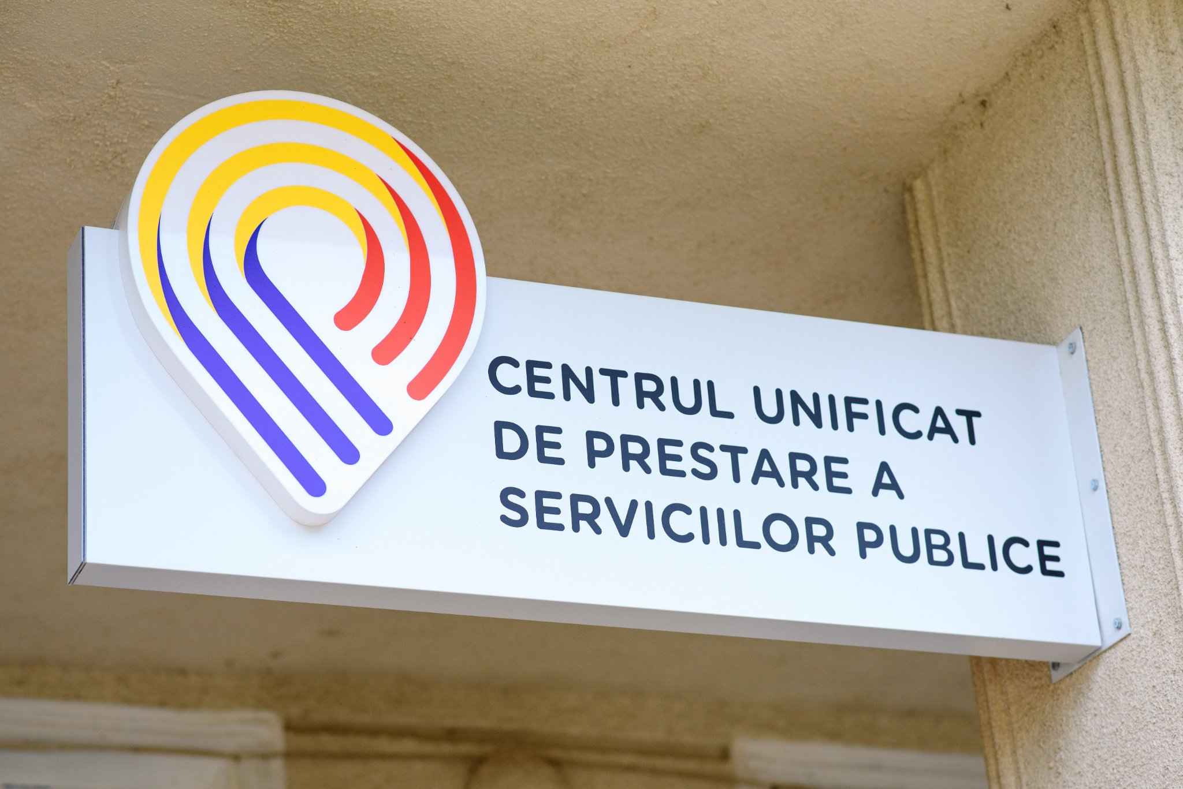
Unified Centers for Service Delivery
💡Alternative public service delivery channel through which the front-office segment of the service is taken over by a third-party institution
💡 An accessible and friendly space, specially equipped with a computer and internet access within the town hall, to be used personally by beneficiaries under the guidance of the CUPS specialist.
💡 Increase the population's access to public services by diversifying the options for accessing them
💡 Support for citizens to increase their digital literacy

Slide 12
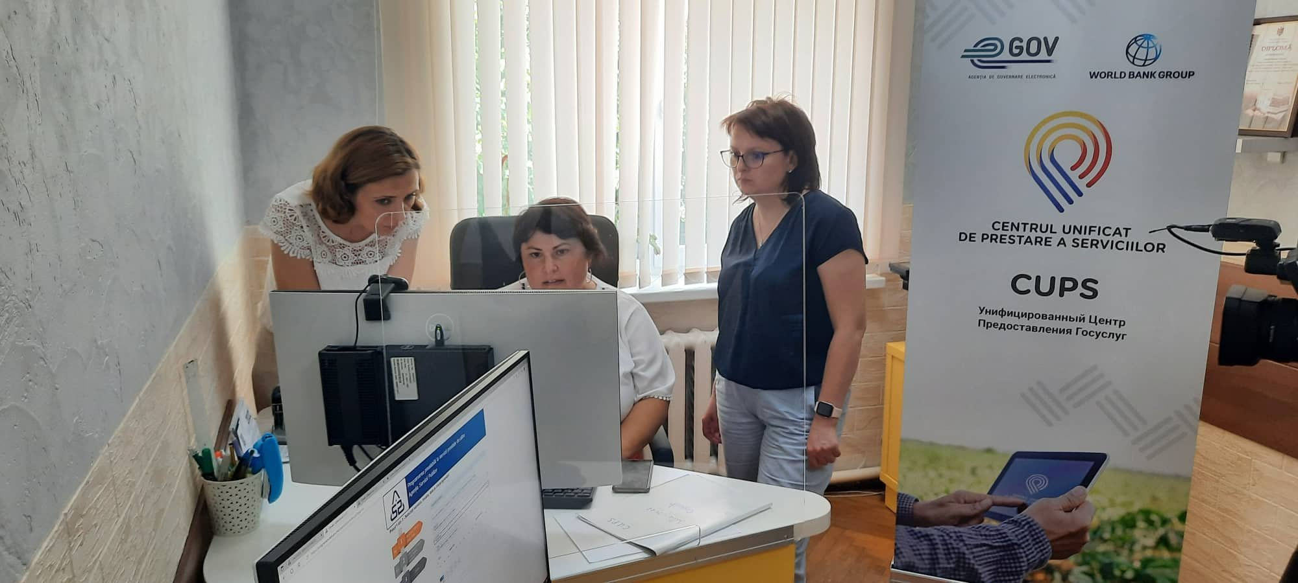
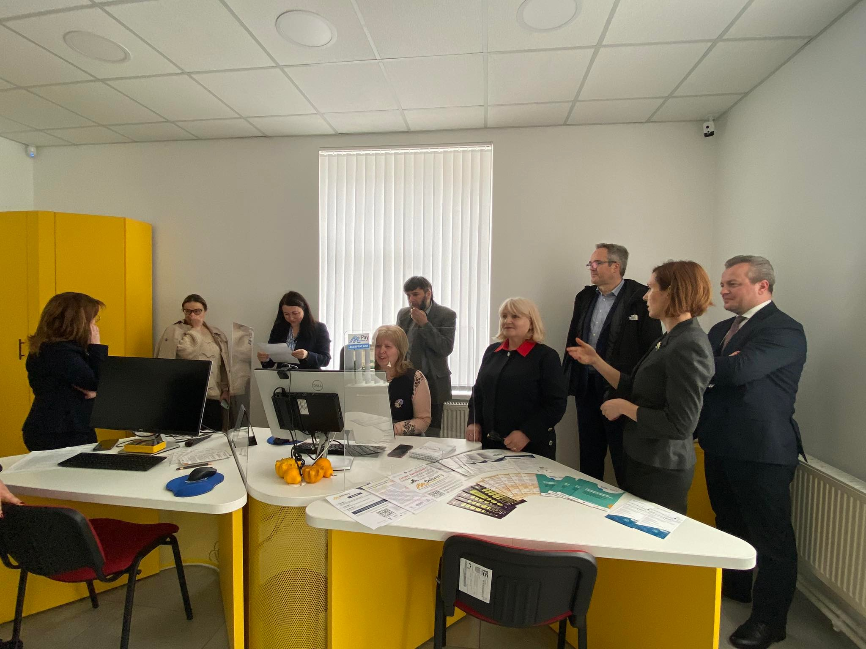
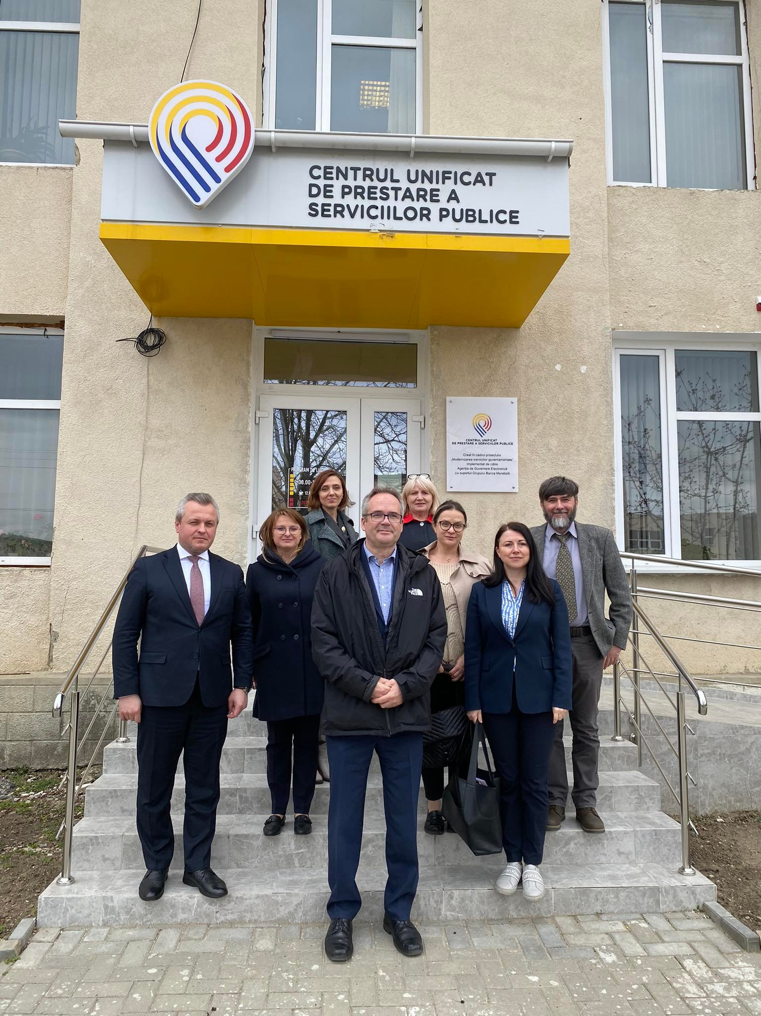

Slide 13


Front-Office Digitization platform (FOD)
allows rapid design and development of front-offices
easily configure and develop individual systems for governmental service providers
can be integrated with any existing service provider back-office
The main beneficiaries of FOD-based services are citizens, businesses, and public service providers.
Notes:
The e-Government Agency of the Republic of Moldova (EGA) has won the Digital Service Design Special Prize in the contest organized by the International Telecommunication Unit and GovStack.
The Front-Office Digitization platform (FOD) is a framework that allows rapid design and development of front-offices for digital government services. FOD components are used to easily configure and develop individual systems for governmental service providers. Optionally, FOD can be integrated with any existing service provider back-office. The main beneficiaries of FOD-based services are citizens, businesses, and public service providers.
Building on a re-engineering methodology, FOD focuses on reusing data and other available electronic platforms and tools to simplify or eliminate public service requests, minimize the time needed to respond to requests and ensure efficient back-office operations. This approach creates a scalable and sustainable technical infrastructure on which beneficiaries can develop services. As a result, users do not have to physically go to the public service provider to request, pay or receive the service. In the case of electronic document requests, documents are delivered only through electronic channels.
In Moldova FOD is integrated with all the e-government systems such as the digital registers (MConnect), identity and verification (MPass), payments (MPay), notification (MNotify), as well as registration, workflow, analyses and many others and uses a multitude of open-source solutions. FOD is already being used for services like the Extract from the State Register of Legal Entities and Individual Entrepreneurs; Extract from the Real Estate Register and Extract from the Civil Status Register. Other FOD-based digital services are currently underway.

Slide 14


