Slide 1
Performance Appraisal System in Civil Service in Georgia
Prof. Dr. Catherine Kardava
Head of the Civil Service Bureau
26 September 2019

Slide 2
The Aim of Performance Appraisal is to
Ensure effectiveness and efficiency of the civil service of Georgia
Stimulate continuous professional growth and development of civil servants
Support approximation of Georgian civil service system towards European standards

Slide 3
The Aim of Performance Appraisal is to
Support merit based career advancement
Serve as a motivation instrument
Create ground for a number of other legal consequences

Slide 4
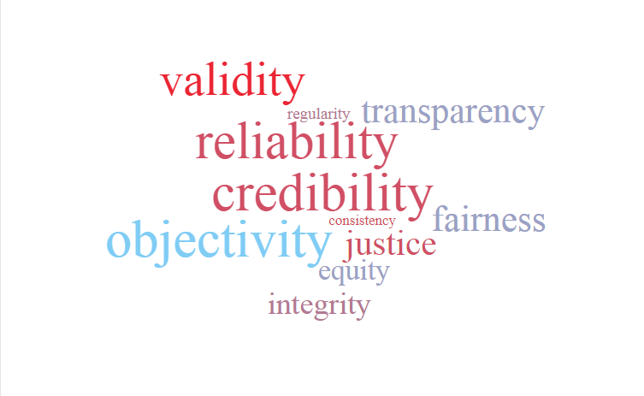

Slide 5
Performance Appraisal Results 2018

Slide 6
Challenges
Absence of institutional/organizational development plans
Lack of knowledge and experience
Violation of confidentiality of employee’s performance assessment results
Inconsistency of interpretations
Inflation of the assessment

Slide 7
Recommendations and Future Plans
Define competences and explain the performance appraisal rating in more details
Define appraisal cycle as 12 months period of performance instead of calendar year
Introduce self-evaluation system
Civil servants who are on leave should perform job responsibilities no less than 6 months to become subject to performance appraisal

Slide 8
Thank you for your attention!
www.csb.gov.ge / info@csb.gov.ge

