Slide 1

THE COMPETENCIES FRAMEWORK IN PUBLIC ADMINISTRATION IN NORTH MACEDONIA: A COMPARATIVE APPROACH
PROF.DR
JAHI JAHIJA

Slide 2

Law on administrative servants
Defines four professional requirements categories:
1. Professional qualifications
2. Work experience
3. General job competencies
4. Special job competencies for all levels

Slide 3
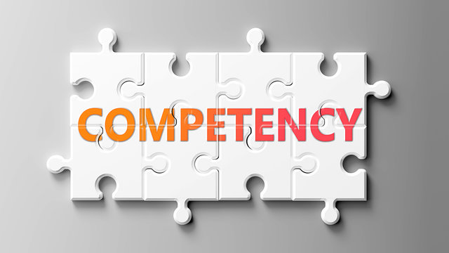
General job competencies
Rulebook on the Framework of General Job Competencies for Administrative Servant
problem-solving and deciding on matters within the scope of the job
learning and development
communication
achieving results

Slide 4
5. working with others / teamwork
6. strategic awareness
7. orientation towards the parties / stakeholders
8. management
9. financial managemen

Slide 5






EPSO (European Personnel Selection Office)
General secretary
European Court of Auditors
Court of Justice

Slide 6

EPSO Competency Framework
1. Critical thinking, analysing & creative problem-solving
2. Decision-making & getting results
3. Information management (digital and data literacy)
4. Self-management

Slide 7
5. Working together
6. Learning as a skill
7. Communication
8. Intrapreneurship

Slide 8

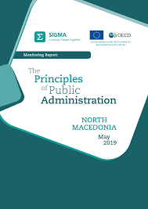
Why do we compare?
Strategic
2) Policy development and coordination,
(3) Public service and human resource management,
(4) Organization, accountability and oversight
(5) Service delivery and digitalization
(6) Public financial management (PFM).
SIGMA (Support for Improvement in Governance and Management) is a joint initiative of the OECD and the EU .

Slide 9
2022
2014
Decision-making & getting results
Working together
Communication
Achieving results
Working with others / teamwork
Communication

Slide 10
RECOMMANDATION
Change/update the Rulebook on the Framework of General Job Competencies for Administrative Servant
Global best practices
There is no “Best way doing things”
Modify them (political, administrative and organisation culture)

Slide 11
RECOMMANDATION – EPSO
Self-management
Organises own tasks, demonstrates responsibility and a constructive attitude at all times
Information management (digital and data literacy)
Translates knowledge and skills through digital tools and technologies
Learning as a skill
Actively manages own learning, growth and self improvement
Intrapreneurship
Drives change, inspires and empowers others in implementing change and offers guidance at all levels.

Slide 12


